Slide 1
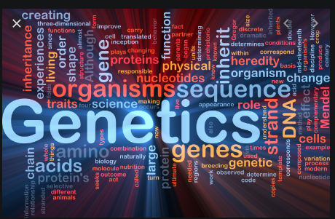
Topic 7

Slide 2
Videos to Watch - Heredity
Click on the link and watch the following videos before you continue with this section on Heredity ** Remember to take the BrainPop Quiz, screenshot of your results and upload it in to the “Assignment” in TEAMS.
Brain Pop: Heredity
Amoeba Sisters: DNA, Chromosomes, Genes, & Traits: An Intro to Heredity

Slide 3
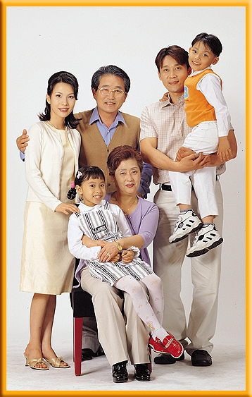
Heredity-Genetics
Heredity – is the passing of traits from parent to offspring (child).
Eye color, nose shape, and many other physical features are some of the traits that are inherited from parents.

Slide 4
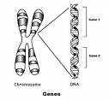
Heredity
Genes on chromosomes control the traits that show up in an organism.
The different forms of a trait that a gene may have are called alleles.

Slide 5
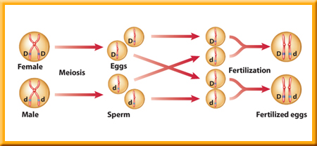
Heredity
3. During meiosis a pair of chromosomes separates and alleles move into separate sex cells.
4. Each sex cell now contains one allele for each trait. (So you get one allele from each parent)

Slide 6
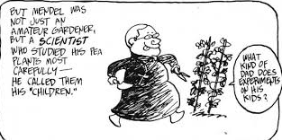
5. The study of how traits are inherited is genetics.

Slide 7
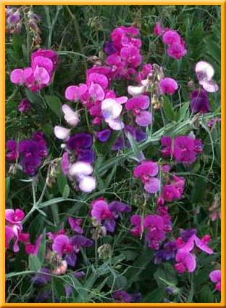
B. Gregor Mendel – The Father of Genetics
1. Mendel was a monk who studied pea plants in the late 1800s.
2. He was the first to use the mathematics of probability to explain heredity and to trace one trait for several generations.

Slide 8
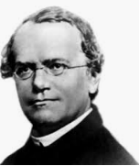
B. Gregor Mendel – The Father of Genetics
3. Mendel had 3 main principles of heredity.
a. Traits are controlled by alleles on chromosomes.
b. An allele’s effect is dominant or recessive.
c. When a pair of chromosomes separates during meiosis, the different alleles for a trait move into separate cells.

Slide 9
Videos to Watch - Genetics
Click on the link and watch the following videos before you continue with this section on Genetics ** Remember to take the BrainPop Quiz, screenshot of your results and upload it in to the “Assignment” in TEAMS.
Brain Pop: Genetics
Amoeba Sisters: Monohybrids and the Punnett Square Guinea Pigs

Slide 10
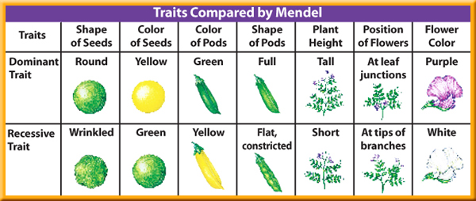
C. GENETICS
1. A hybrid receives different genetic information for a trait from each parent.
a. Dominant allele – covers up or dominates the other trait.
b. Recessive allele – the trait seems to disappear.

Slide 11
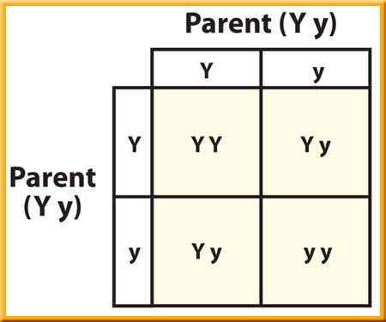
C. Genetics
2. Probability helps you predict the chance that something will happen.
3. A Punnett square can help you predict what an offspring will look like.
a. Upper case letters stand for dominant alleles.
b. Lower case letters stand for recessive alleles.

Slide 12
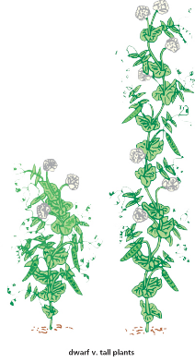
C. Genetics
4. Genotype – the genetic makeup of an organism (what alleles it has for a gene)
a. homozygous – an organism with two alleles for one trait that are the same (TT or tt)
b. Heterozygous – an organism with two alleles for one trait that are different. (Tt)

Slide 13


C. Genetics
Genotype = Ee or EE
Phenotype = Unattached earlobe
Genotype = ee
Phenotype = attached earlobe
5. Phenotype – the way an organism looks and behaves as a result of its genotype.

Slide 14
Genetics Since Mendel
Topic 7

Slide 15
Videos to Watch – Genetics Since
Mendel
Click on the link and watch the following videos before you continue with this section on Genetics Since Mendel** Remember to take the BrainPop Quiz, screenshot of your results and upload it in to the “Assignment” in TEAMS.
Brain Pop: Blood Types
Amoeba Sisters: 1. Incomplete Dominance, CoDominance and Polygenetic Traits 2. Multiple Alleles and Blood Types

Slide 16
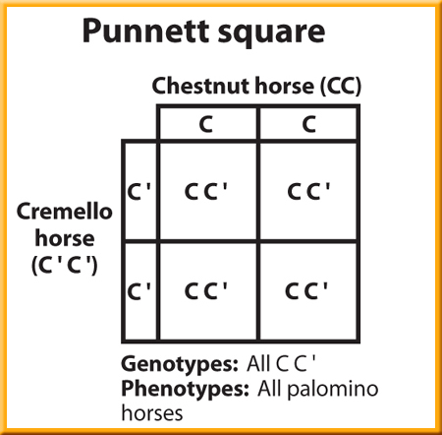
A. INCOMPLETE DOMINANCE
1. Neither allele for a trait is dominant.
2. The phenotype produced is intermediate between the two homozygous parents.
  For traits that show incomplete dominance, instead of using an uppercase letter and a lower case letter, the same uppercase letter is used, but one allele gets the ‘ or prime symbol.

Slide 17
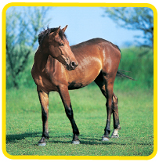
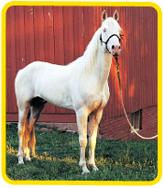
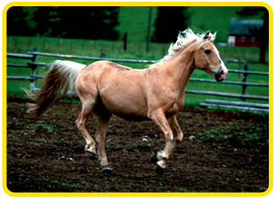
Incomplete Dominance
Neither color is dominant, so heterozygous (hybrid) offspring show a color that is a mixture of the parents’ colors.
Chestnut
Cremello
Palomino

Slide 18
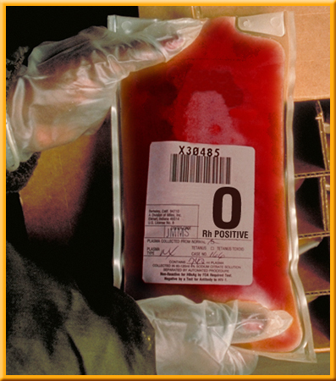
B. MULTIPLE ALLELES
1. More than two alleles that control a trait are called multiple alleles.
2. Traits controlled by multiple alleles produce more than three phenotypes
3. Human blood type is an example of having 3 different alleles which combine to make 4 different phenotypes.

Slide 19
How does blood type work?
There are 3 alleles for blood type in humans A, B, and O
There are 6 genotypes possible AB, AA, AO, BB, BO, and OO
There are 4 phenotypes for blood type in humans AB, A, B, and O

Slide 20
Blood type cont.
a. The A and B alleles are codominant which means they are both expressed. The O allele is recessive.
b. A person with type A blood could have the genotype AA or AO
c. A person with type B blood could have the genotype BB or BO
d. A person with type O blood can only have the genotype OO since O is recessive.
e. A person with type AB blood can only have the genotype AB since they are codominant.

Slide 21
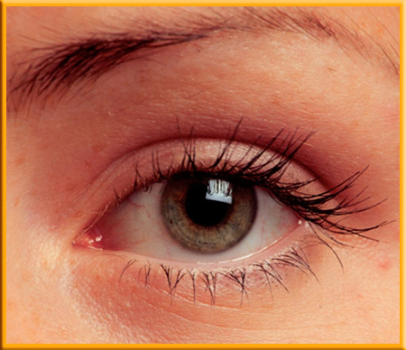
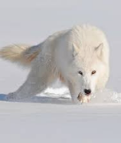
C. POLYGENIC INHERITANCE
A group of gene pairs act together to produce a trait, which creates more variety in phenotypes.
Many human traits are controlled by polygenic inheritance, such as hair and eye color.
3. Many polygenic traits are affected by the environment, for example many alleles are expressed only under certain temperature conditions.

Slide 22
Videos to Watch –Mutations
Click on the link and watch the following videos before you continue with this section on Mutations ** Remember to take the BrainPop Quiz, screenshot of your results and upload it in to the “Assignment” in TEAMS.
Brain Pop: Genetic Mutations

Slide 23
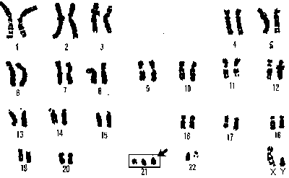
D. MUTATIONS – genes that are altered or copied incorrectly
1. A mutation can be harmful, helpful, or have no effect.
2. Chromosome disorders – caused by more or fewer chromosomes than normal.
3. Down’s syndrome – caused by an extra copy of chromosome 21.

Slide 24
E. RECESSIVE GENETIC DISORDERS
1. Both parents have a recessive allele responsible for the disorder and pass it to their child.
2. Because the parents are heterozygous, they don’t show any symptoms. They are called a carrier.
3. Cystic fibrosis is a homozygous recessive disorder.

Slide 25
Videos to Watch – Sex Determination and Sex Linked Disorders
Click on the link and watch the following videos before you continue with this section on Sex Determination/Linked Disorders** Remember to take the BrainPop Quiz, screenshot of your results and upload it in to the “Assignment” in TEAMS.
Brain Pop: Sex Determination
Amoeba Sisters: 1.Punnett Squares and Sex Linked Traits 2. Pedigrees

Slide 26
F. SEX DETERMINATION
1. Chromosomes that determine the sex of an organism are XX in females and XY in males.
2. Females produce eggs with an X chromosome only. Males produce sperm with either an X or a Y chromosome.
 | X | Y
X | XX | XY
X | XX | XY

Slide 27
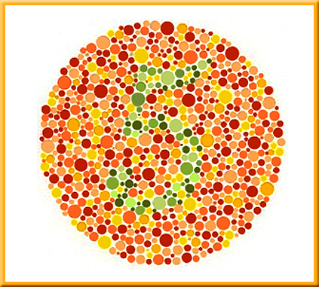
G. SEX-LINKED DISORDERS
An allele inherited on an X or Y chromosome is a sex-linked gene.
2. Color blindness is a sex-linked disorder caused by a recessive allele on the X chromosome.

Slide 28
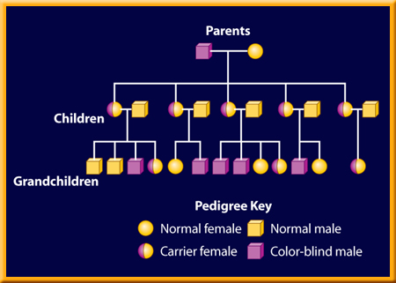
G. Sex Linked
3. A pedigree follows a trait through generations of a family.
a. females are represented as circles
b. males are represented as squares

Slide 29
Heredity – Advances in Genetics
TOPIC 7

Slide 30
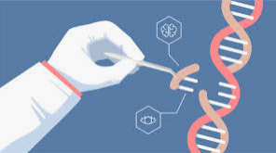
A. Genetic Engineering
Genetic Engineering – changing the arrangement of DNA that makes up a gene.

Slide 31
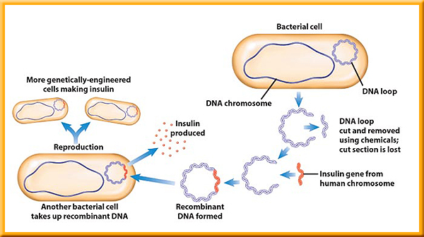
A. Genetic Engineering
1. Recombinant DNA
a. Insertion of a useful segment of DNA into a bacterium.
b. Example: Insulin is made by genetically engineered organisms.

Slide 32
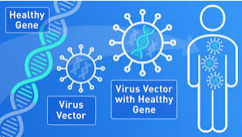
A. Genetic Engineering
2. Gene Therapy
a. A normal allele is placed into a virus, which delivers the normal allele when it infects its target cell.
b. May be used to control cystic fibrosis or other genetic disorders.

Slide 33
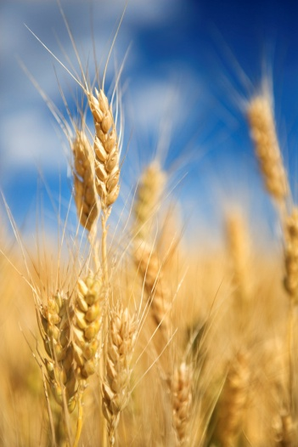

B. Genetic Engineered Plants
B. Genetically engineered plants
– created by inserting the genes that produce desired traits in one plant into a different plant.

Slide 34
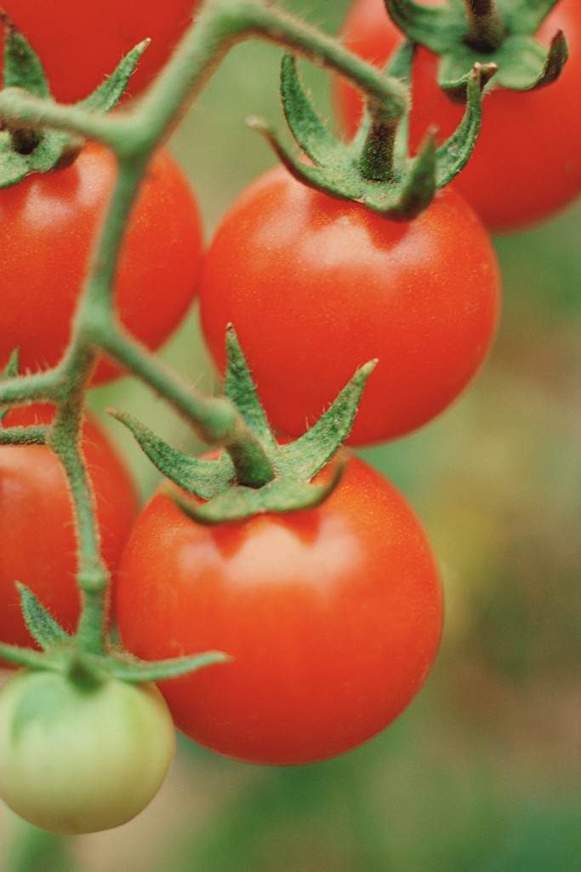
B. Genetic Engineering
1. Examples
a. tomatoes are given a gene that lets them be picked green and then ripen slowly so they are firm when they reach stores.
b. other crops have been engineered to be resistant to diseases and pests.

Slide 35
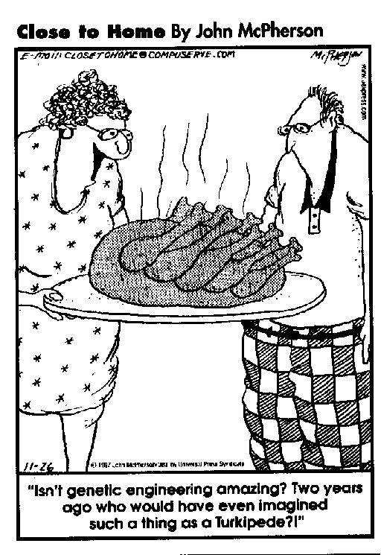
B. Genetic Engineering
2. Concerns
a. the long-term effect of consuming genetically engineered food is unknown
b. some stores label genetically engineered food now so you can choose to eat it.

